Slide 1
ENGINE TESTING DYNAMOMETER with control system

Slide 2
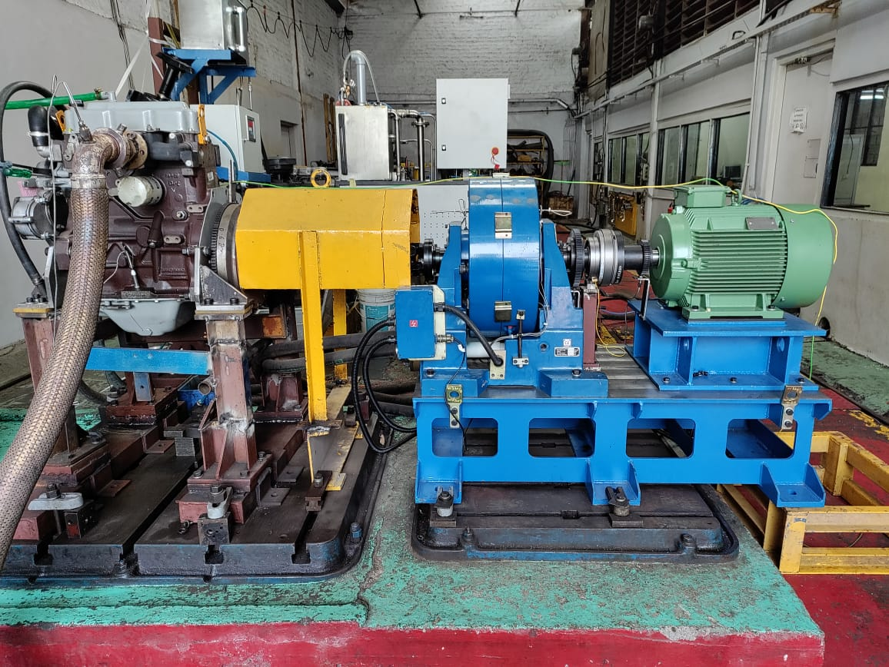
Engine with Dynamometer

Slide 3
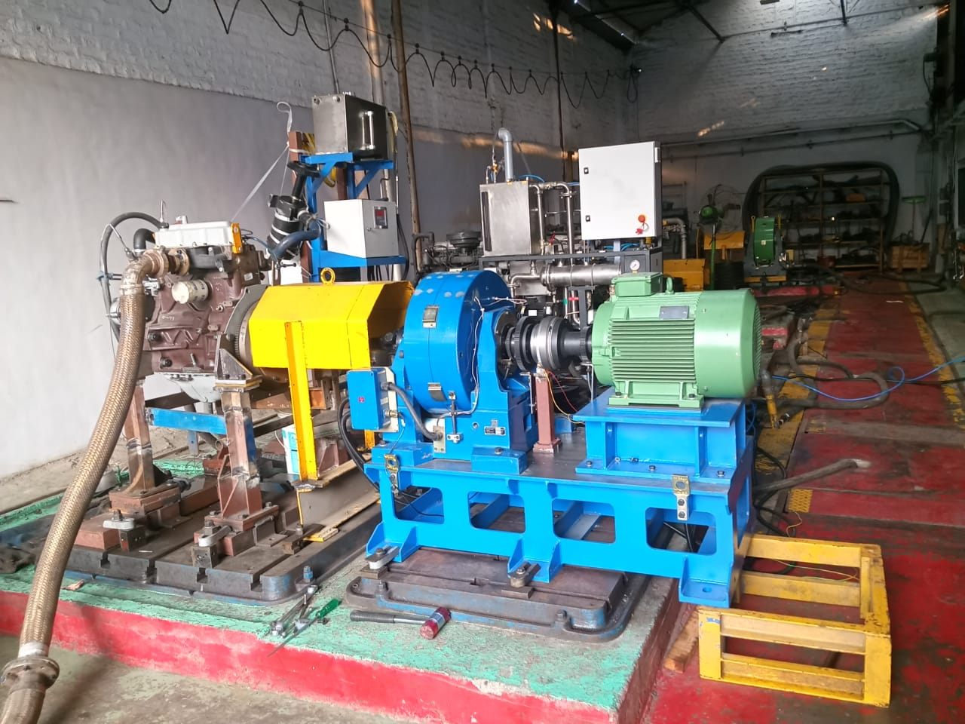

Slide 4
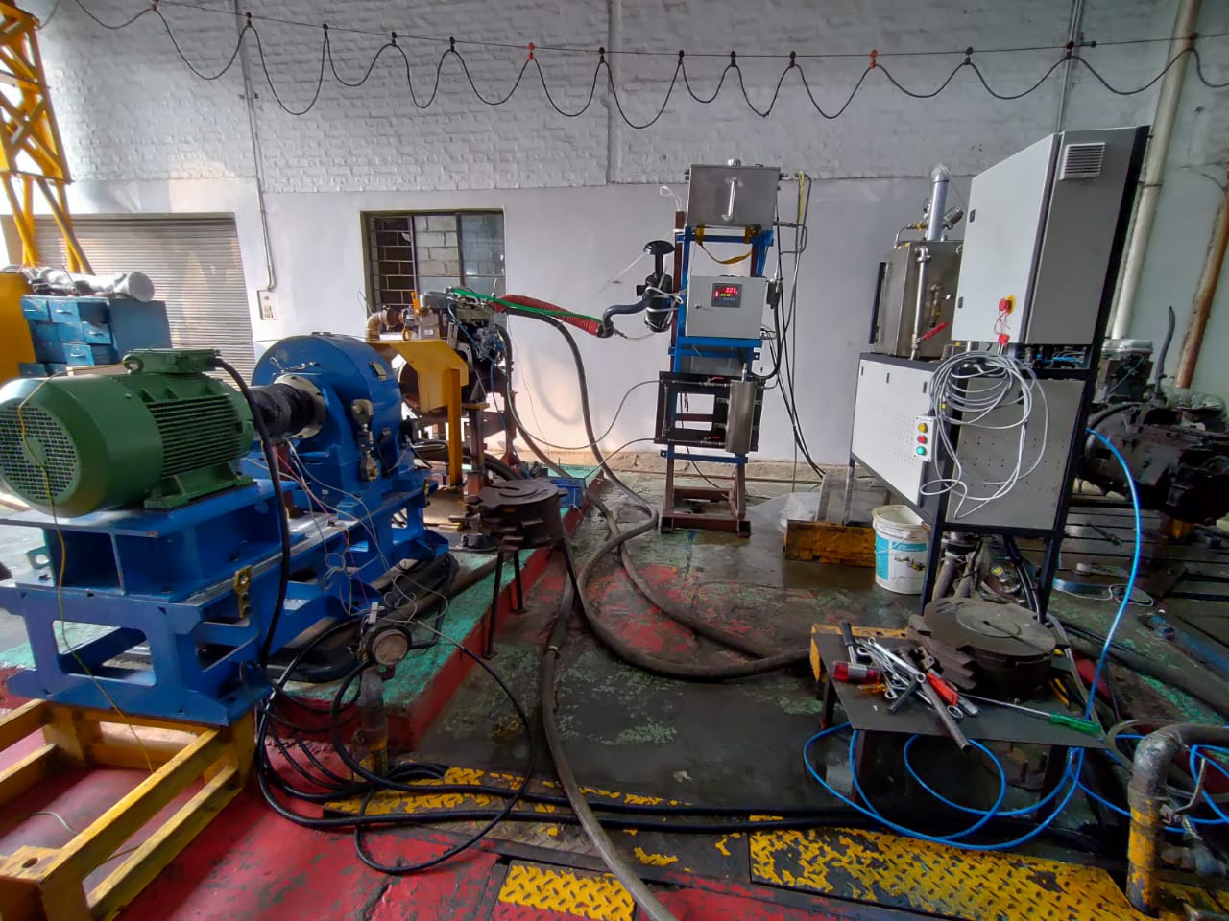

Slide 5
Introduction
Engine performance :
It is an indication of the degree of success of the engine performance its assign task.i.e the conversion of chemical energy contained fuel into useful mechanical work.

Slide 6
Purpose of Engine TESTING
Testing the operating behaviour of engine
Performance of Engine
Verify Max power of Engine
Verify Max Torque of Engine
Check Repeatability
Check Reproducibility.

Slide 7
Performance of Engine
The Performance of Engine is evaluated on the basis of the following parameters,
Engine Air Intake temperature
Engine Fuel & Lubrication oil Inlet Temperature & Pressure
Engine Water inlet/outlet Temperature & pressure
Engine Exhaust Gas temperature
Specific Fuel Consumption
Ambient temp & Humidity
Engine Exhaust smoke & others Emissions

Slide 8
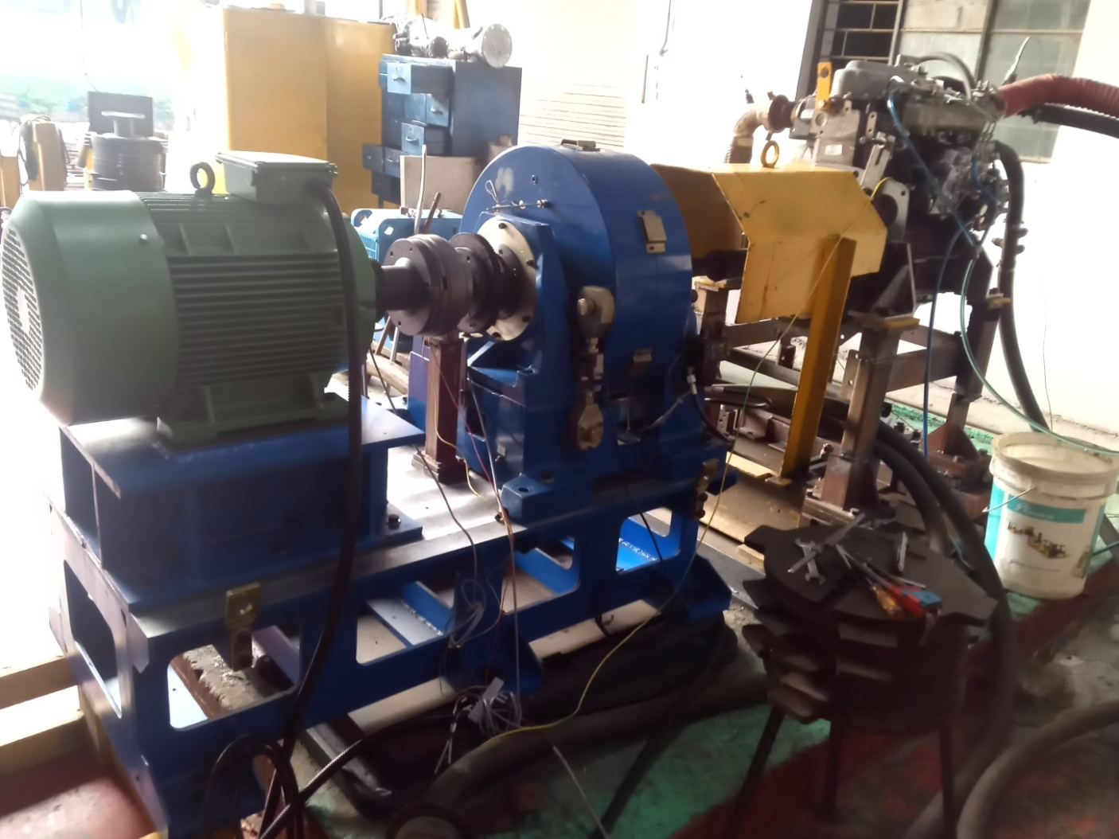

Slide 9
Basic Measurements
The Basic Measurements to be undertaken to Evaluate the performance of an Engine on almost all tests are the following
Speed : Magnetic Pulse pick up sensor
Torque: Load cell
Temperature: Temperature sensors
(PT100,Cr-Al Type)
Pressure : Pressure sensors
Fuel Flow & Consumption :
Gravimetric & Volumetric type

Slide 10
Dynamometer
Dynamometer would be capable of absorbing & measuring power in both directions of rotation .
Dynamometer is used to provide Torque on Engine when Engine is in Running condition. For measurement torque value ,high accuracy precision strain gauge load cell used.
Speed Measurement Dynamometer has 60 teeth wheel & magnetic pulse pick up. when magnetic pulse pick up sensor sense the 60 teeth then it measure 1 rpm (Revolution per minute)
Temp & pressure Parameter of Dynamometer can be measure using sensors . Water In /out

Slide 11
CONTROL MODES
We can test Engine using below modes :
Open loop mode :
Here No feedback ,No PID action
only Engine run at its max speed & put load using dynamometer
Constant Speed mode (PID action)
In constant speed of Engine we have set engine speed whatever as per specifications of Engine & by using PID action dynamometer will put load for maintaining set speed (2000rpm )
Constant Torque Mode (PID action)
In constant Torque mode , we need to run Engine at max speed & set torque set point so that using PID action it maintain torque point whatever we have given to our controller.

Slide 12
INTERLOCKS
Dynamometer water inlet pressure
Dynamometer loss plate temperatures
Engine water Inlet temperature : 80/85 degree C
Engine fuel inlet Temperature : 40 Degree C
Engine Air Intake temperature :25 Degree C
Engine Lubrication Oil Temperature :120 Degree C
Engine Lubrication Oil pressure : above 0.5 bar g
Zero speed interlock
Emergency stop
Engine & dynamometer are connected through Cardan shaft in that cardan shaft guard is there for safety interlock which should be close during Engine Running .So limit switch interlock is used for status of guard open or close .
High torque

Slide 13
When Previous all conditions will satisfied then and only then system will go into reset that means we can put load or start engine testing otherwise we can’t do .

Slide 14
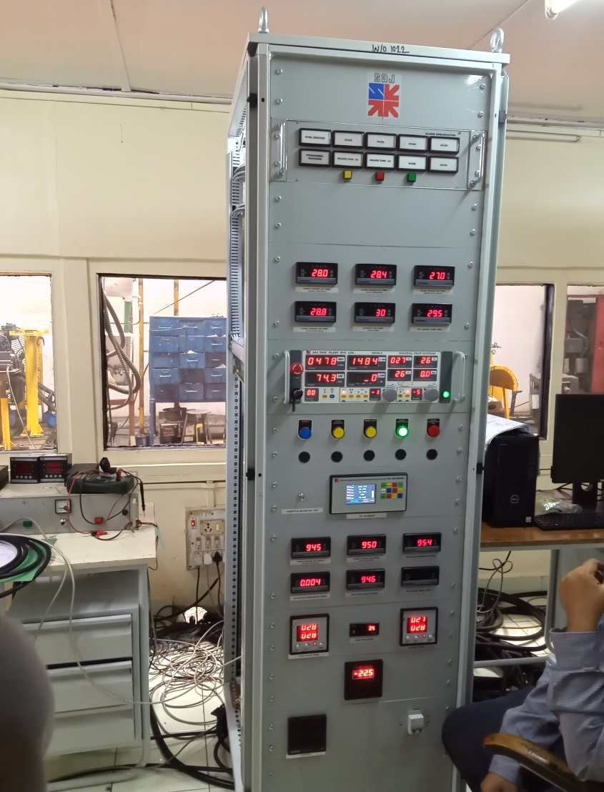
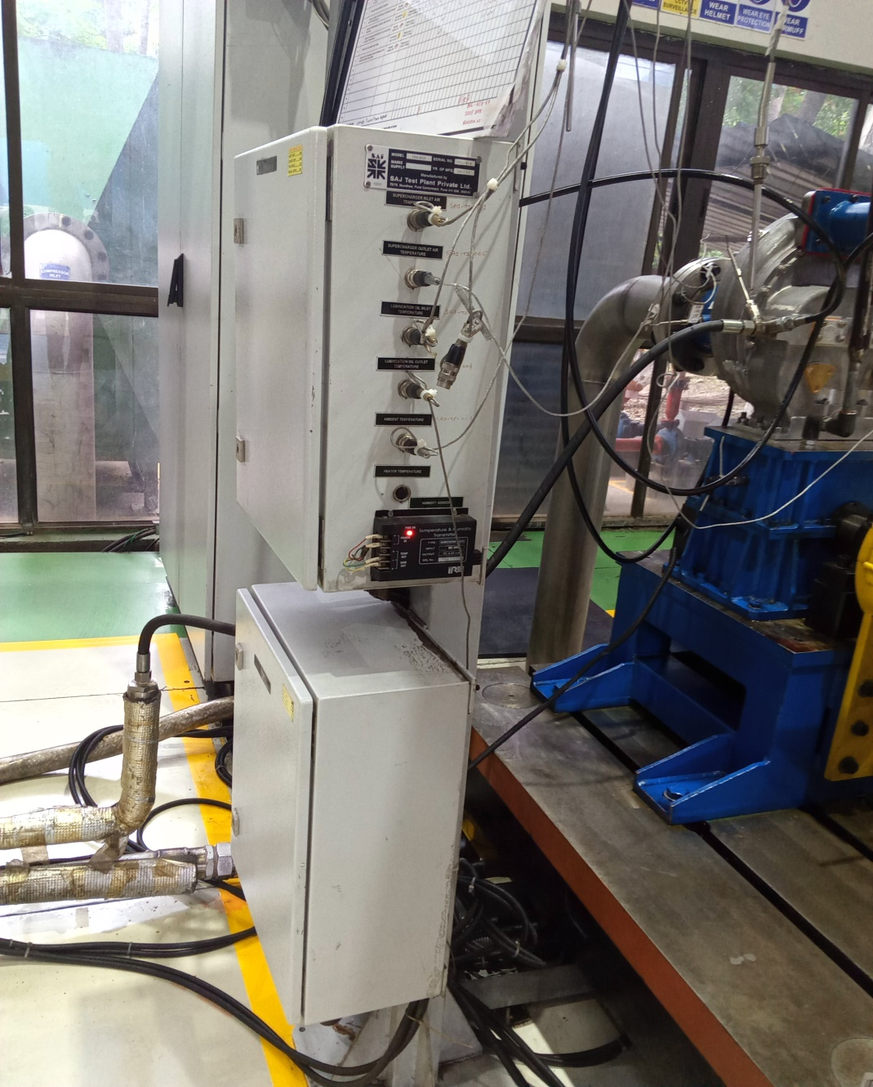

Slide 15
Instrumentation Part
We will use Data acquisition unit for displaying
All temperature & pressure parameters related to Engine & dynamometer.

Slide 16
Fuel consumption Measurements
There are 2 types of fuel measurements
Volumetric type
in this measurements method fuel volume is measure in the Volume ( unit CC)
Gravimetric Type:
In this measurements method fuel given to engine in the form of weight (gm)

Slide 17
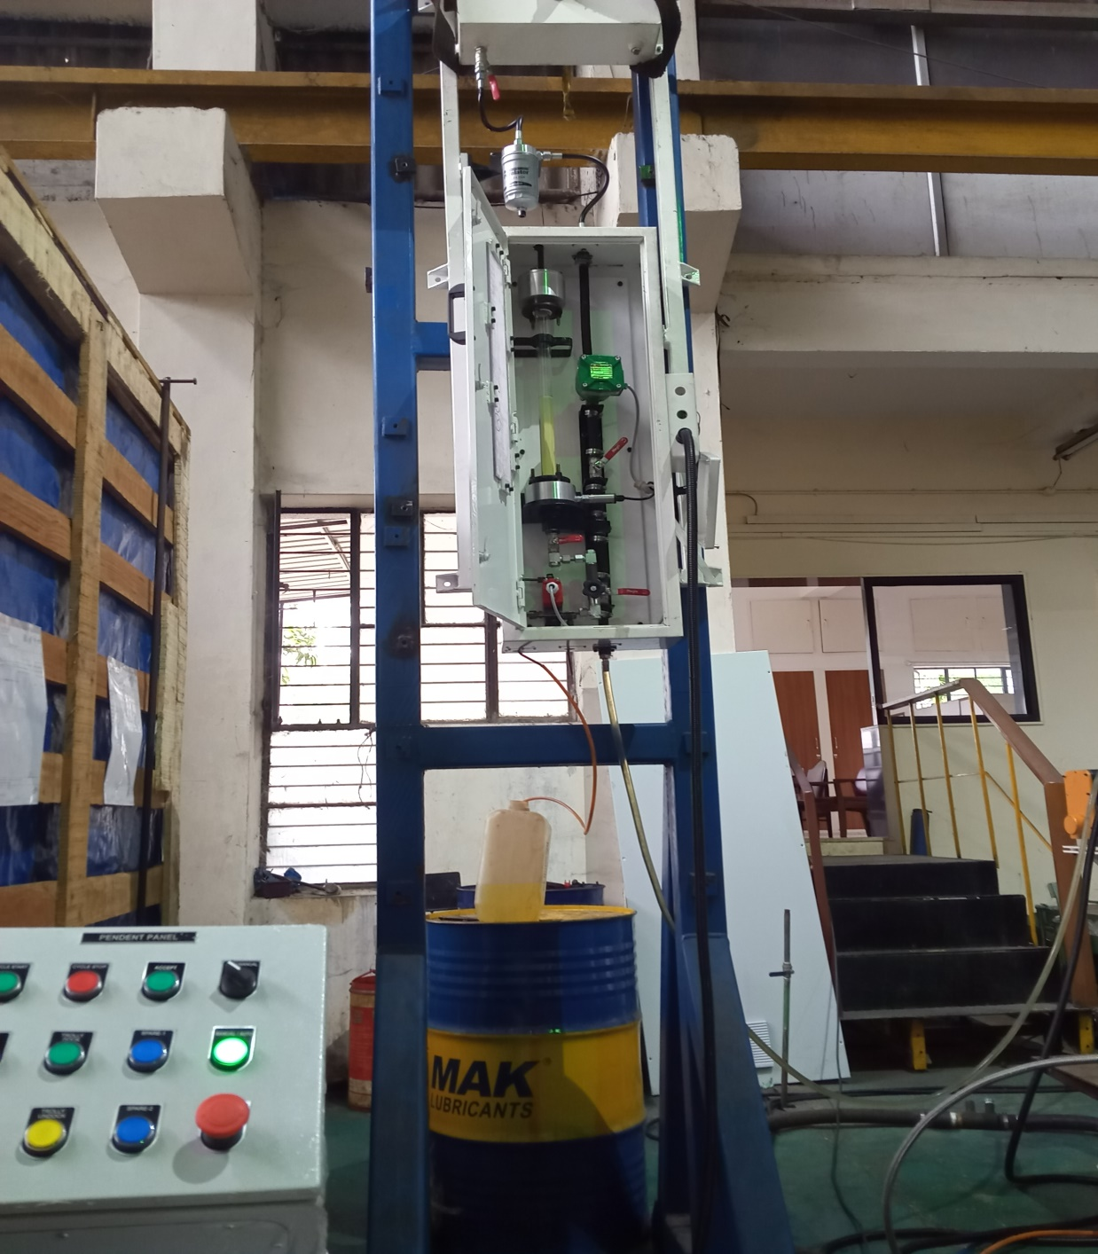
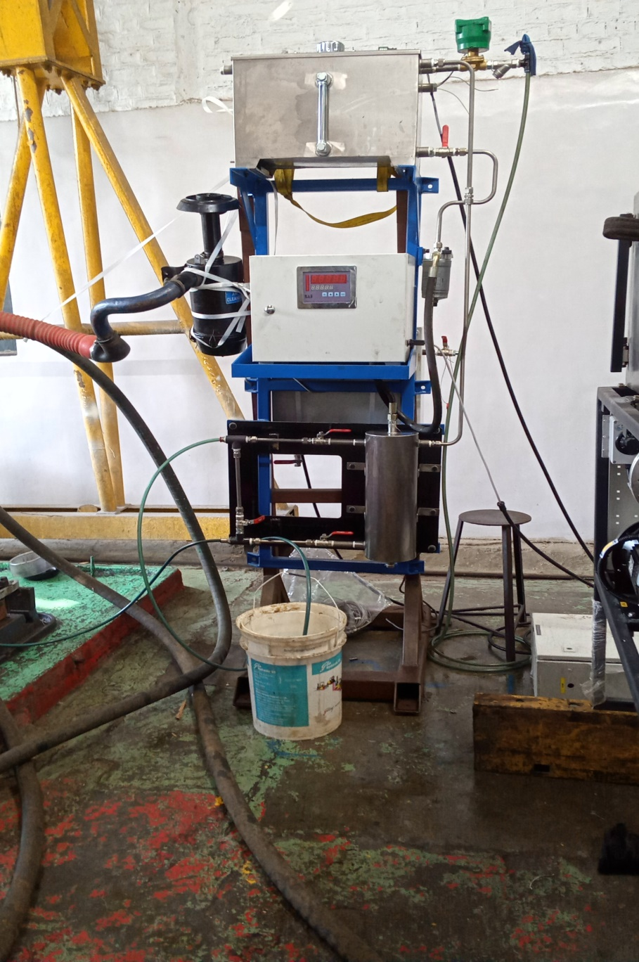

Slide 18
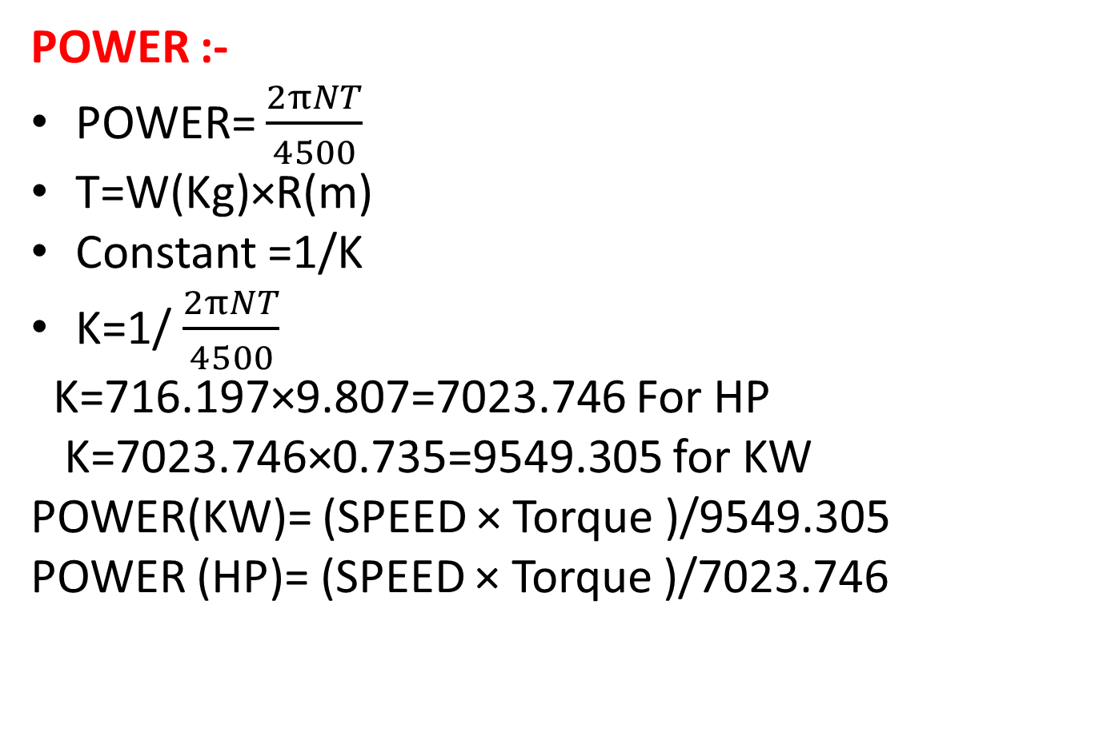
Formulae
POWER :-
POWER= $\frac{2πNT}{4500}$
T=W(Kg)×R(m)
Constant =1/K
K=1/ $\frac{2πNT}{4500}$
K=716.197×9.807=7023.746 For HP
K=7023.746×0.735=9549.305 for KW
POWER(KW)= (SPEED × Torque )/9549.305
POWER (HP)= (SPEED × Torque )/7023.746

Slide 19
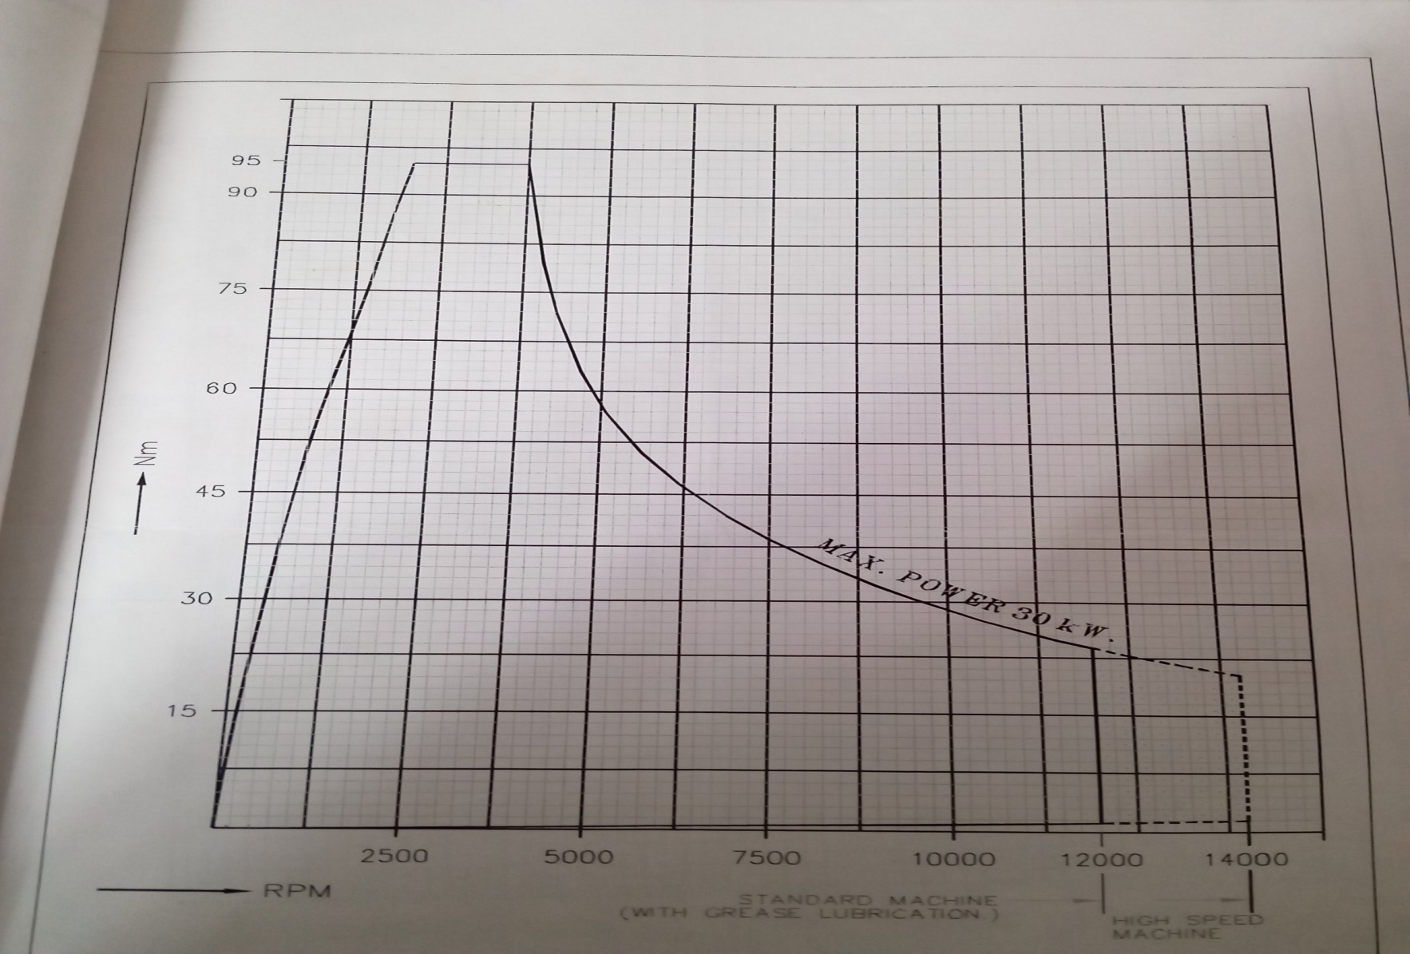

Slide 20
Specific Fuel Consumption :
For Gravimetric
SFC (gm/kw-hr)
= gm /(speed × Torque )/9549.305 ×(1/60)
=(gm ×9549.305 ×60)/speed ×Torque
=(gm ×573000)/(Torque × Revolution)
SFC (gm/kw-hr)=
=(573000 × Fuel weight in gm)/ Torque × Revolutio

Slide 21
